Slide 1
Theorie Bioinformatica
Faster, better, stronger

Slide 2
De stof komt uit de college presentaties en Jonathan Pevsner "Bioinformatics and Functional Genomics"
(Wiley Blackwell; 3e editie) en een aantal extra papers
(deze worden expliciet in de betrokken colleges genoemd, en zijn te vinden onder "achtergrond").
College | Onderwerp | Hoofdstuk | Pagina's | Opmerkingen
1 | Recap Bioinf 1 | 3-4 | Zie Bioinf1 | Deze stof wordt bekend verondersteld!
2 | Next Generation Sequencing | 9 | 377-423 | Niet de source code in je hoofd stampen!
3 | RNASeq | 11 | 479-515,519-528 | Niet de letterlijke R code, niet fig 11.17, 11.18, 11.19, 11.20
4 | Multiple Sequence Alignment | 6 | 205-217, 221-223 | Niet Box 6.3
8/9 | Assembly | 9/15 | 395-398,730-736 | Bestudeer ook de Powerpoint extra!
10 | The Burrough-Wheeler transform for mapping reads | 5
3 | Phylogeny | 7 | 245-289 | Niet Box 7.2,

Slide 3
Presentation content
Chapter 3: pg. 70 – 103
Chapter 4:
pg. 121 – 134, 138 – 143 and 145 - 159

Slide 4
layout
Alignment
MSA
PAM scorings matrix
BLAST

Slide 5

Alignment
The Fundamental operations of Bioinformatics
Developed by Dayhoff, Needleman & Wunsch in the 70’s
Answers two fundamental questions:
Where is my sequence in a reference?
Which sequence are related by evolution?

Slide 6
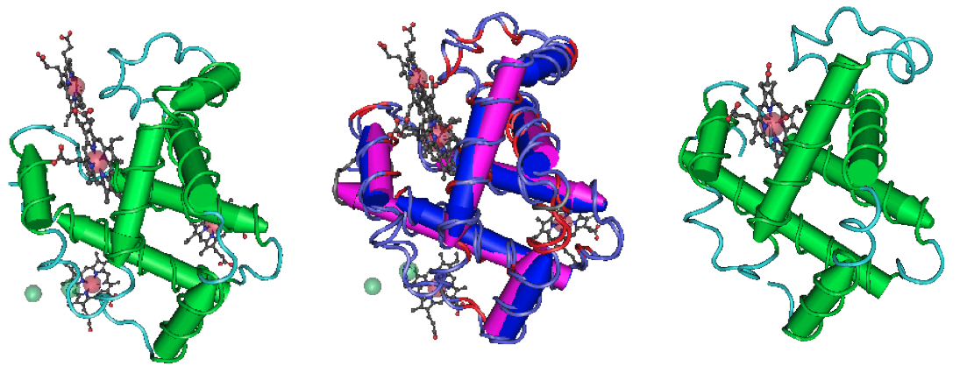
Homology: a visual definition
Beta globin
(NP_000509)
Myoglobin
(NP_005359)

Slide 7
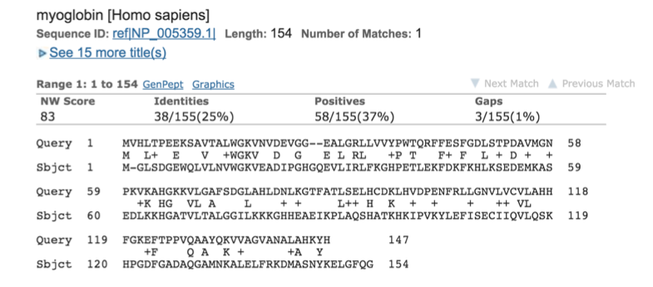
Alignment
Protein alignment more informative:
Changes in the DNA do not always result in a amino acid change
Amino acids share related biophysical properties

Slide 8
Homology: the definition
Pairwise alignment:
The process of lining up two sequences to achieve maximal levels of identity (and conservation, in the case of amino acid sequences) for the purpose of assessing the degree of similarity and the possibility of homology
Homology:
Homologous, “if they share a common evolutionary ancestry”
Orthologs:
Orthologs, ”are homologous sequences in different species that arose from a common ancestral gene during speciation
Paralogs:
Are homologs sequences that arose by mechanism such as gene duplication

Slide 9
Homology: the definition
Pairwise alignment:
The process of lining up two sequences to achieve maximal levels of identity (and conservation, in the case of amino acid sequences) for the purpose of assessing the degree of similarity and the possibility of homology
Homology:
Homologous, “if they share a common evolutionary ancestry”
Orthologs:
Orthologs, ”are homologous sequences in different species that arose from a common ancestral gene during speciation
Paralogs:
Are homologs sequences that arose by mechanism such as gene duplication

Slide 10
Paralogs and Orthologs

Slide 11
Alignment – at the heart of:
Determining othologs and paralogs and what is known about them
Determining whitch proteins or genes are present in a particular organism
Determining the idenity of a DNA or protein sequence
Discovering new genes
Determining what variants have been described for a particular gene or protein
Investigating expressed sequence tags that may exibit alternative splicing
Exploring amino acids residues that are important in the function and or structure of a protein

Slide 12
What does alignment look like?
Let’s try it with Myoglobin & Beta globin: NP_000509 and NP_005359
https://blast.ncbi.nlm.nih.gov/Blast.cgi
https://www.ebi.ac.uk/Tools/psa/

Slide 13
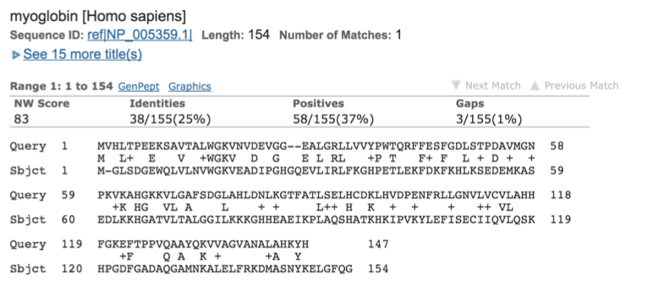
What does alignment look like?

Slide 14
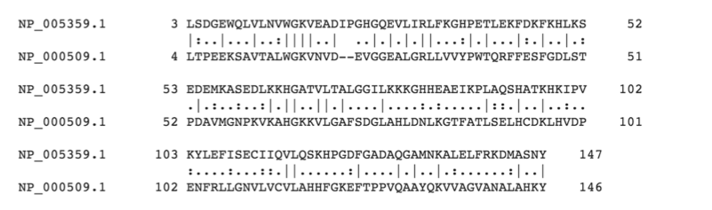
What does alignment look like?

Slide 15
Local vs Global alignment
Global alignment (Needleman-Wunsch): extends from the one of each sequence of the other
Local alignment: finds the optimally matched regions within two sequence (“sub-sequences”)
Local alignment is almost always used for databases searches such as BLAST. It is useful to find domains (or limited regions of homology) within sequences.
Smith & Waterman (1981) solved to the problem of performing optimal local sequence alignment. Other methods (BLAST, FASTA) are faster but less thorough)

Slide 16
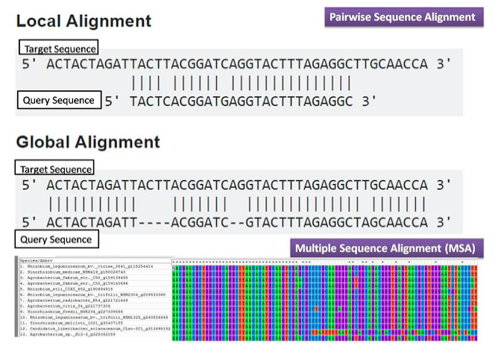
Pairwise and global alignment

Slide 17
What does alignment look like?
Let’s try it with Cytoblomin
NP_599030.1 and NP_599030.1
NP_599030.1 and CAJ44466.1
Global versus local alignment
https://www.ebi.ac.uk/Tools/psa/

Slide 18
Alignment is about evolution
Pairwise alignment:
The process of lining up two sequences to achieve maximal levels of identity (and conservation, in the case of amino acid sequences) for the purpose of assessing the degree of similarity and the possibility of homology

Slide 19
Pairwise sequence alignment allows us to look back billions of years ago (BYA)
When you do a pairwise alignment of homologous human and plant proteins, you are studying sequences that last shared a common ancestor 1.54 billions years ago

Slide 20
Multiple sequence alignment of Glyceraldehyde 3-phosphate dehydrogenases: example of extremely high conservation

Slide 21
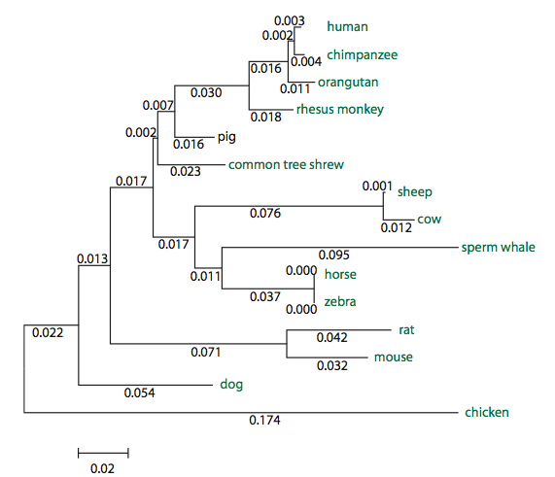
Orthologs: members of a gene (protein) family in various organisms
Myoglobin orthologs

Slide 22
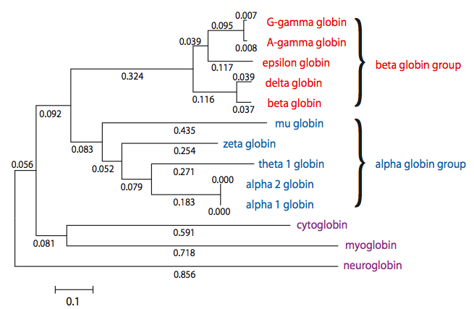
Paralogs: members of a gene (protein) family within a species
Human globins

Slide 23
Make a MSA using MEGAX
Use the sequences provided on Blackboard

Slide 24
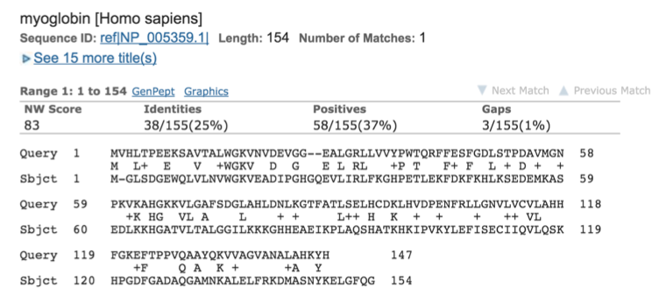
Similarity = Identity + Conservation

Slide 25
Similarity = Identity + Conservation
Identity: The extend to which two (nucleotide of amino acid) sequences are invariant
Conservation: Changes at a specific position of an amino acid of (less commonly, DNA) sequences that preserve the physico-chemical properties of the original residue
Similarity: The extend to which nucleotide or protein sequences are related. It is based upon identity plus conservation

Slide 26
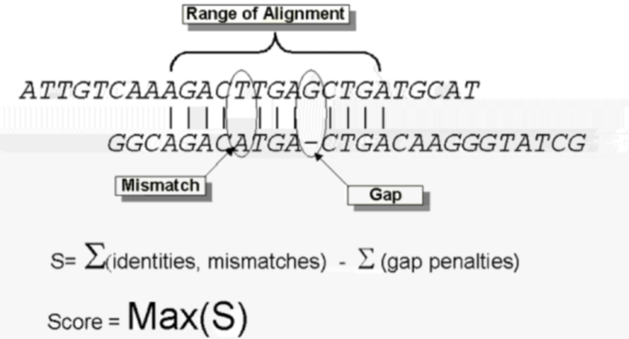
Alignment algorithms use a score

Slide 27
How to score “conservation”??
For nucleotide alignments, it’s easy: a mismatch get a penalty
For amino acid alignments, mismatches may not be so bad: if biochemical function is preserved
But… How do we know that?

Slide 29
But.. Evolution itself can help us!
Margaret Dayhoff realized you can look back in the evolutionary record to recognize what AA is an “acceptable” substitution for another AA

Slide 30
But.. Evolution itself can help us!
Margaret Dayhoff realized you can look back in the evolutionary record to recognize what AA is an “acceptable” substitution for another AA
You need an initial alignment of course…
This was done by hand with all the known globins at the time (70’s)

Slide 31
Matrices: PAM (Point Accepted Mutation)
Align lots of proteins
Count how often AA’s can substitute for each other
Normalize by how often an AA occurs anyway
Construct the mutation probability matrix (change of a mutation occurrence, 1 PAM)
Perform matrix duplication to obtain derived PAM matrices (high PAM for more divergent sequences)
Construct the relatedness odds matrix (what is the probability of aa j will change into aa i in a homologous sequence)
Log transform to make log-odds score (nicer to work with for computers and statisticians (easier when computing the overall alignment score))

Slide 32
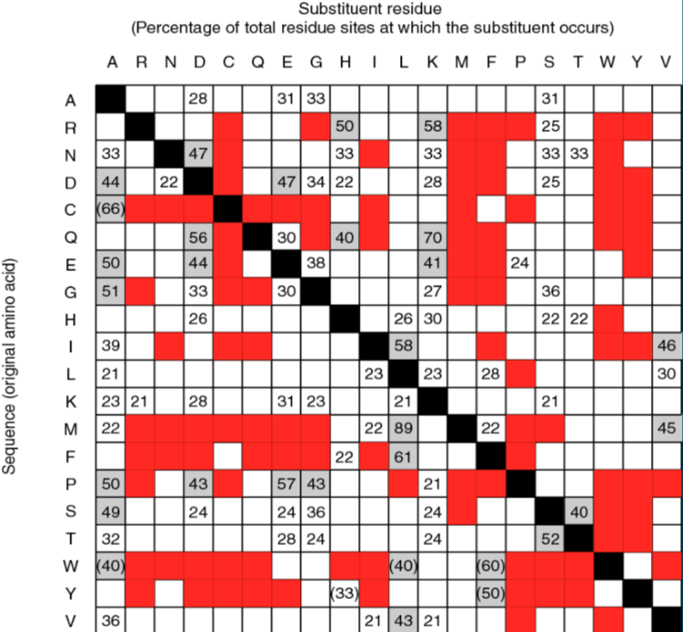
Numbers: percentage observed substitution
Red: never observed substitutions
Gray: very conservative substitutions
Black: identities
Empty: rare substitutions
( x ): small sample size

Slide 33
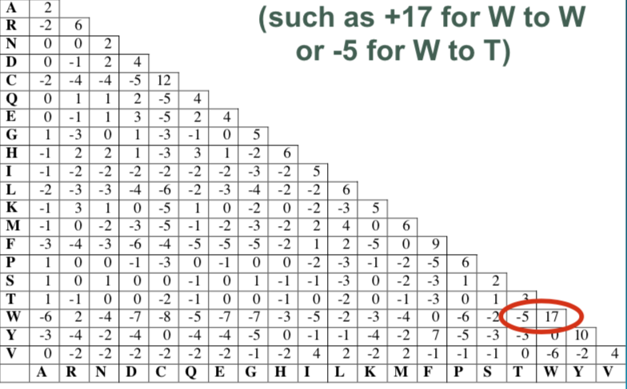
Where we’re heading: to a PAM250 log odds scoring matrix that assigns scores and is forgiving of mismatches…

Slide 34
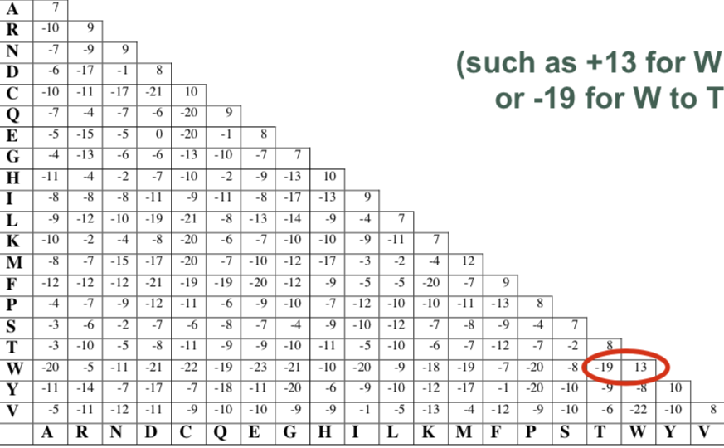
.. And to whole series of scoring matrices such as PAM10 that are strict and stringent for mismatches

Slide 35
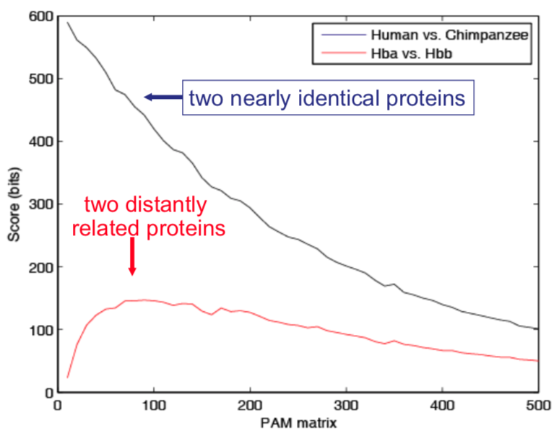
Choose your matrix wisely!!

Slide 36
BLOSUM(62): a PAM alternative
Henikoff & Henikoff (1992)
Used blocks of distantly related aligned protein sequences
Made a series of BLOSUM matrices.
BLOSUM50: assumes 50% similarity,
BLOSUM62: assumes 62% similarity,
Etc
Most commonly used scorings matrix

Slide 37
Relation between PAM and BLOSUM matrices
BLOSUM 90
PAM 30
Less divergent
Human versus
Chimpanzee beta globin
BLOSUM45
PAM250
More divergent
Human versus
Bacterial globins
A higher PAM number, and a lower BLOSUM number, tends to correspond to a matrix tuned to more divergent proteins.

Slide 38
Effect of scorings matrix on the alignment?
Let’s try it with Myoglobin & Beta globin: NP_000509 and NP_005359
Using different matrices: PAM and BLOSUM
https://blast.ncbi.nlm.nih.gov/Blast.cgi

Slide 39
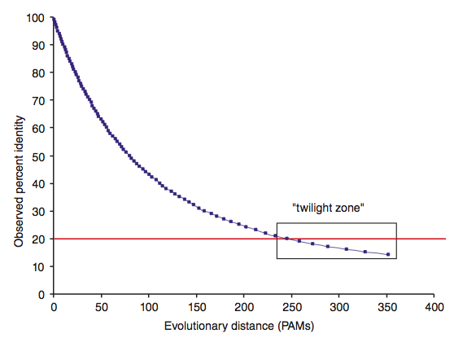
The “Twilight Zone”, limits of detection

Slide 40
How to find a needle…. FAST!
We’ve got millions or billions of subsequences to find back in a reference
The reference could be billions of bases itself
The human genome
The whole of all know sequences (all of NCBI or EBI)

Slide 41

So, ”How do they do it ??”

Slide 42
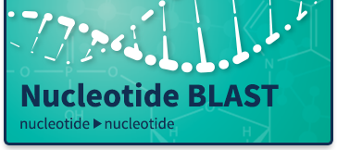

Slide 43
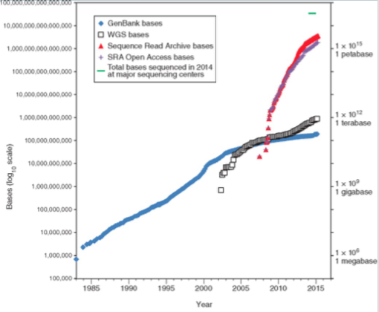
BLAST: Making alignment for homology... FAST!!

Slide 44
BLAST: Making alignment for homology...
The BLAST famility of alignment programs allows you to search for homology with a query sequence in a database
Potentially all known sequences
In reality, you want to search specific databases
Examples:
Non-redundant (nr) database
RefSeq (Human & Mouse curated)
Genbank (all know sequences)
Expressed Sequence Tags (ESTs)
SRA (sequence Read Archive; all reads)

Slide 45
The BLAST flavors
BLASTn: nucleotide query search for homology
BLASTp: amino acid query search for homology
tBLASTn: translated amino acid query
BLASTx: translated nucleotide query
tBLASTx: translated amino acid query to translated nucleotide DB
PSI-BLAST: find homology using automated customized score matrix

Slide 46
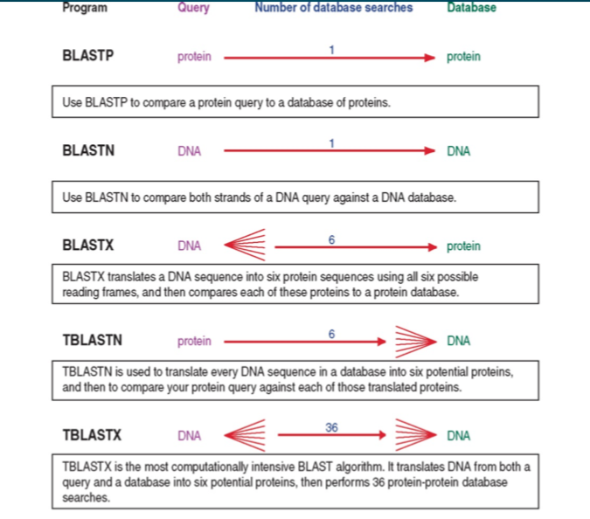
The BLAST flavors

Slide 47
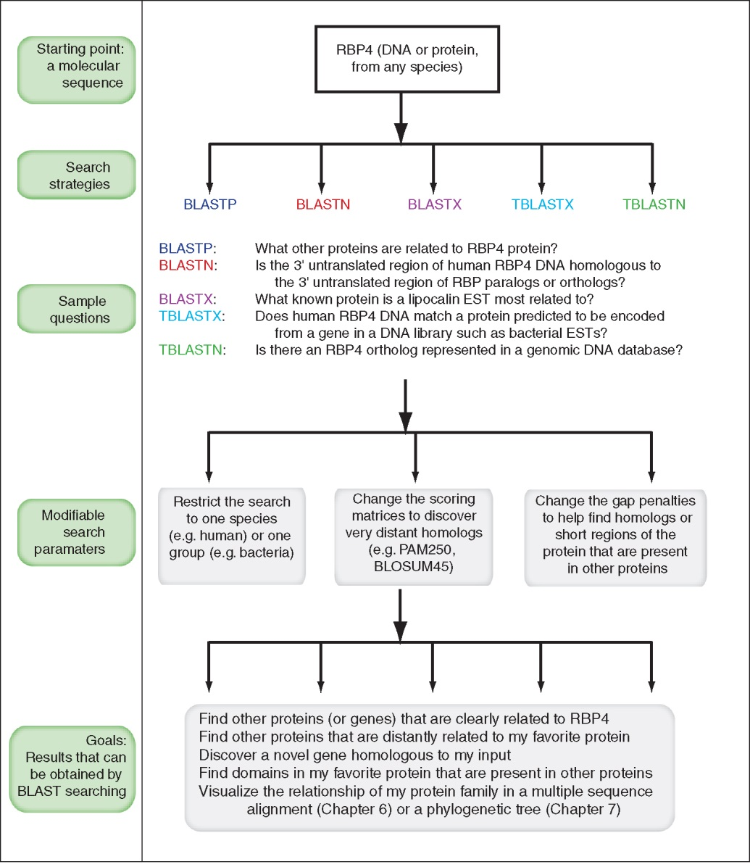
The choices…

Slide 48
The algorithm
Choose two sequences
Select an algorithm that generates scores
Allow gaps (insertions, deletions)
Score reflects degree of similarity
Alignments can be global or local
Estimate probability that the alignment occured by change (and report a statistic for it!)

Slide 49
BLASTs: How do they work?
Build and index of small words (nucleotide, amino acids) that are found in your sequence database
When a BLAST starts, split your query into these words and look them up in the database
If you find a match, perform an actual (local) alignment
Crucial parameters: word-size and alignment-threshold

Slide 50
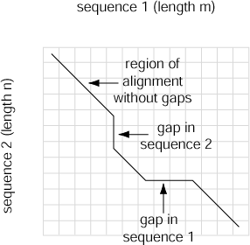
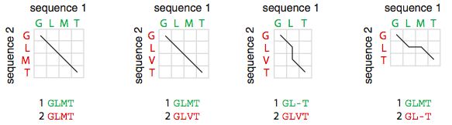
During alignment

Slide 51
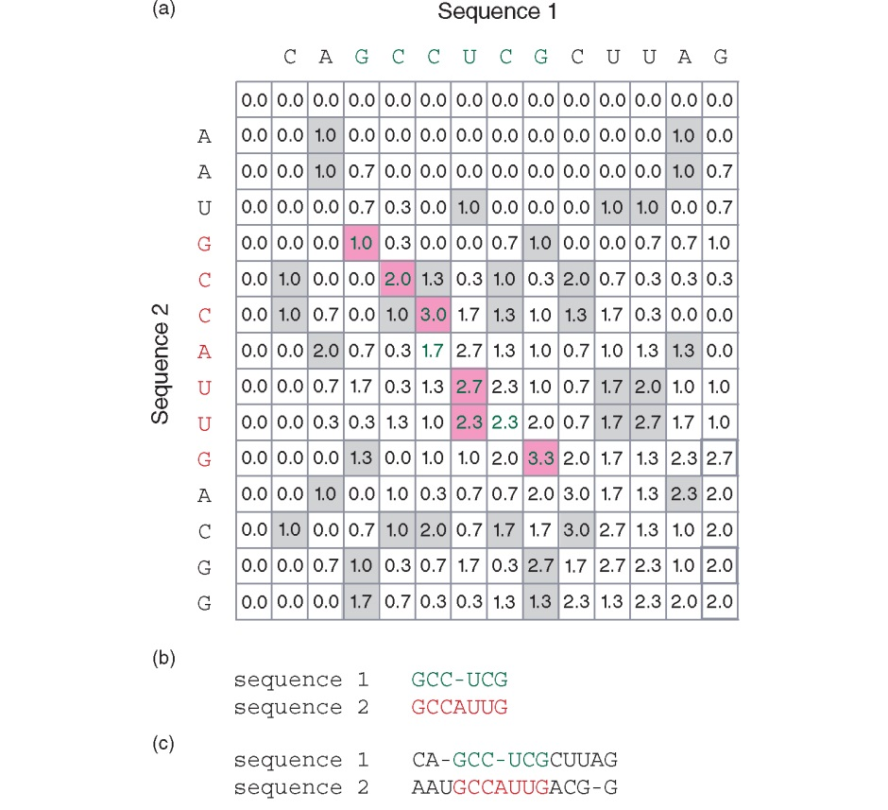
Smith & Waterman (local alignment)
The score S_{(i,j)} is given as the maximum
of four possibilities:
1. S_{(i-1,j-1)}; match of mismatch score
2. S_{(i,j-1)}; left cell – gap penalty
3. S_{(i-1,j)}; cell above – gap penalty
4. The number 0

Slide 52
Smith & Waterman (local alignment)
Local alignment
Global alignment

Slide 53
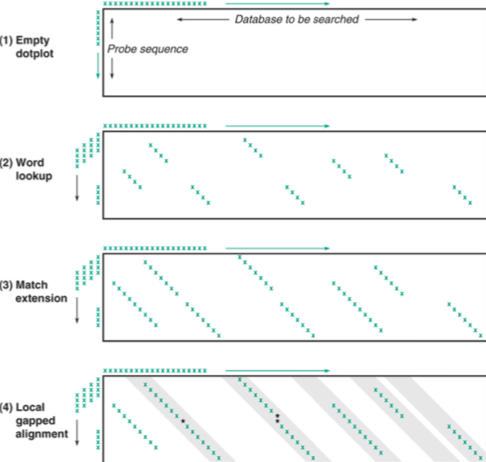
Dotplot of seeding and alignment
Important BLAST parameters
affecting this process:
T : Threhold
W : Wordsize

Slide 54
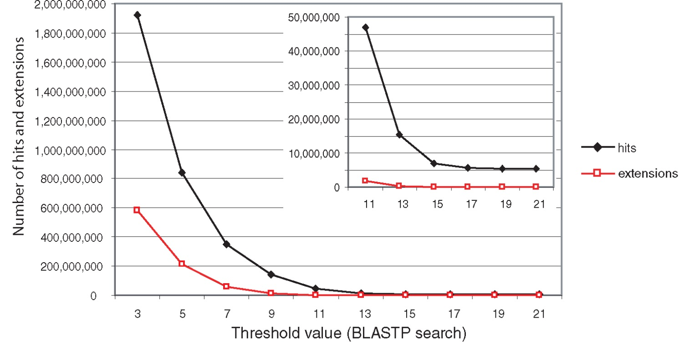
Effect of changing the threshold T: Lower T yields more database hits (black line) and extensions (red)

Slide 55
How “good” is a BLAST result?
You need a statistical measure to tell you how likely it is that an alignment is not statistical fluke
This is related to the well known ”p-value” in experimental sciences: you reject the Null-hypothesis with a level of confidence
For experiments: p = 0.05 or p = 0.01
Alignment (e.g. Needleman-Wunsch global alignment) is judged by Z-score
For BLAST, this statistics is the “E-value”

Slide 56
Karlin-Altschul statistics provide a theory for computing the probability that a local alignment of a given score will be found between two random sequences of the same lengths as the query and database sequences

Slide 57
The value of E decreases exponentially with increasing S (higher S values correspond to better alignments). Very high scores correspond to very low E values.
The E value for aligning a pair of random sequences must be negative! Otherwise, long random alignments would acquire great scores
Parameter K describes the search space (database).
For E=1, one match with a similar score is expected to occur by chance. For a very much larger or smaller database, you would expect E to vary accordingly
Some properties of the equation E = Kmn e^{-lS}

Slide 58
How “good” is a BLAST result?
You need a statistical measure to tell you how likely it is that an alignment is not statistical fluke
This is related to the well known ”p-value” in experimental sciences: you reject the Null-hypothesis with a level of confidence
For experiments: p = 0.05 or p = 0.01
Alignment (e.g. Needleman-Wunsch global alignment) is judged by Z-score
For BLAST, this statistics is the “E-value”
The Expected number of “random” alignments with the same score ( in the same database, with the same query sequence)

Slide 59
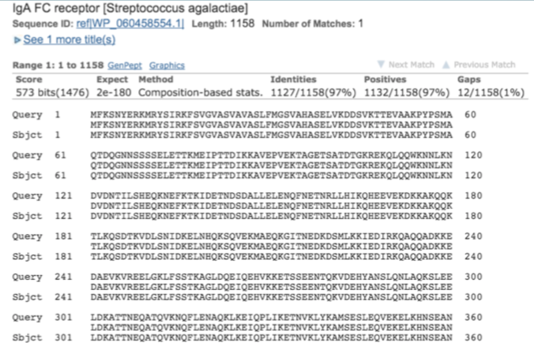
A rough guide to E-values

Slide 60
A rough guide to E-values
Measure the number of “chance” alignments you expect with the same score
Probably homologous
E-value < 0.02 (P < 10^{e-100})
Homology likely
0.02 < E-value < 1
(10^{e-5} < P < 10^{e-1})
This probably just chance
E-value > 1
( P > 0.1)

Slide 61
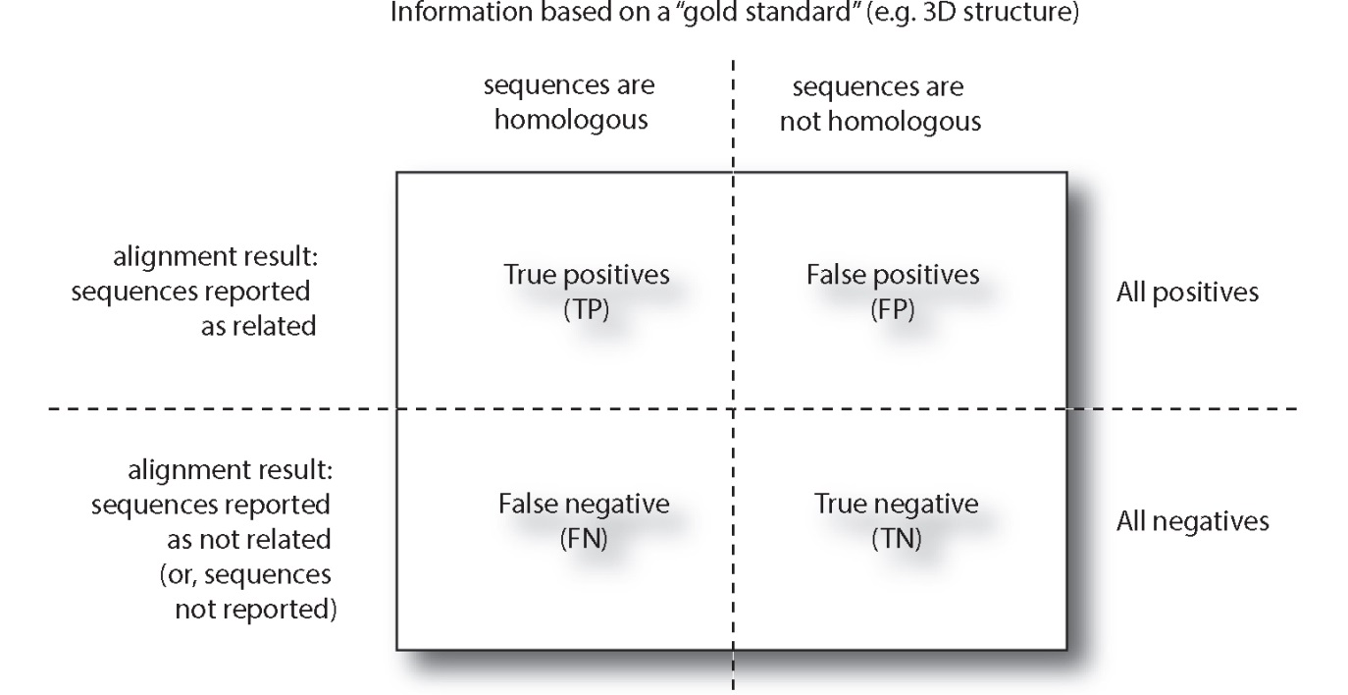
Statistical significance of pairwise alignments
Sensitivity = TP / (TP + FN)
Specificity = TN / (TN + FP)

Slide 62
BLAST: mutated sequences
BLAST the sequences provided on BB

